Slide 1

Savitribai Phule Pune University R. H. Sapat College Of Engineering, Management Studies And Research, Nashik - 422 005 DEPARTMENT OF COMPUTER ENGINEERING A. Y. [2022-23]
Predictive Maintenance on Machine Failure
Presented By
Tanushri Khope (B190694279)
Shraddha Kulkarni (BE190694285)
Shweta Navarkar (B190694301)
Fiza Shaikh (B190694340)
Under Guidance of
Ms. Trupti Atre

Slide 2
Table Of Content
Problem Statement
Introduction
Literature Survey
Existing Systems
Proposed Work
Project Description
Requirements
Tools and Technologies
Objective
Project Flow
Model building
Result
Conclusion
References

Slide 3

Problem Statement
To build a Predictive Maintenance System on Machine Failure with machine learning and data science

Slide 4
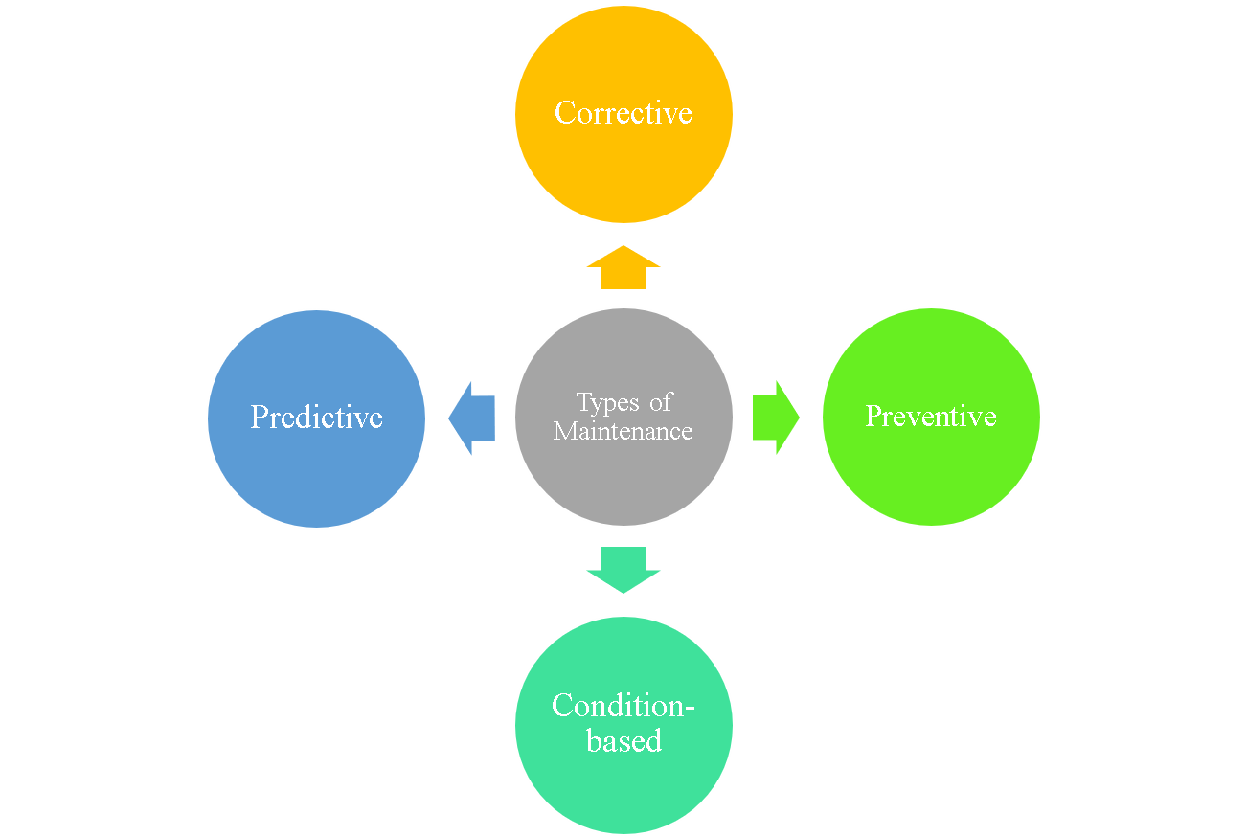
Introduction
What is Predictive Maintenance?
Predictive maintenance is a technique that uses data analysis tools and techniques to detect anomalies in your operation and possible defects in equipment and processes so you can fix them before they result in failure.
What are the types of Maintenance ?
Corrective
Preventive
Condition-based
Predictive

Slide 5
Literature survey
TITLE | AUTHOR | YEAR | PUBLISHER
Predictive Maintenance using Machine Learning | A. Kane, A. Kore, A. Khandale, S. Nigade, P. P. Joshi | 2022 | -
Machine Learning Application in Predictive Maintenance | Karolis Liulys Department of Electrical Engineering Vilnius Gediminas Technical University | 2019 | IEEE
Machine Learning approach for Predictive Maintenance in Industry 4.0 | Marina Paolanti, Luca Romeo Andrea Felicetti, Adriano Mancini Emanuele Frontoni | 2018 | IEEE

Slide 6
Existing Systems
Poor maintenance of machine tool:-Irregular maintenance of machine tools can impact the overall operation. The machine parts require time to time and cleaning
Power Supply Problems:-Failure in power supply results in inaccurate results and CNC machines are not able to operate.
Overheating of Machine Tool:-Machining is a non-stop process and due to high orders machines are working continuously. It results in overheating of the machine tools.
Reduced lifecycle

Slide 7
Proposed Work
Predictive maintenance with Machine learning helps machines or systems predict various types of machine failures and reduce them through various specific techniques.
In industries, re-evaluating their maintenance schedules is necessary for this digitalization era as smart as possible for production enhancements. Predictive maintenance offers great opportunities to businesses for a smarter and more digital facility.

Slide 8
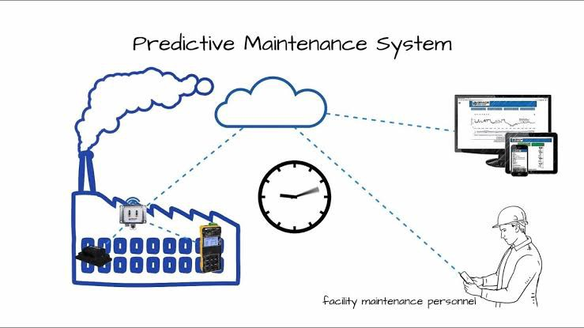
Project Description
Predictive maintenance primarily focuses on detecting upcoming possible failures in the system as well as it also ensures that we will not have to run maintenance frequently. Hence, it also saves money as well as time.
Predictive maintenance methods with machine learning can resolve various challenges associated with maintenance activities, such as unpredicted failures. Thus, this kind of integration is worth exploring to optimize maintenance work and avoid severe consequences during unplanned downtime periods.

Slide 9



Requirements
Hardware Requirement:
System Processor: Core(TM) i5-1135G7
Ram: 8 GB
HardDisk: 512GB
Software Requirement:
Operating System: 64bit Windows 11.
Python Programming Language
Google Colab

Slide 10
Tools and Technologies
Python Libraries for Data Science
Pandas
NumPy
Matplotlib
Seaborn
Front-End Technologies
HTML
CSS
Bootstrap
Back-End Technologies
Python Programming Language
Python Libraries
Tools
Google Colab
Sublime Text

Slide 11
Objective
The objective is to predict when the machine is more likely to fail and classify which type of failure.
Save our asset from failure and can have preventive maintenance.
Secondly we can predict the remaining useful life, that how much time this machine can run properly.
Target variable:-Machine failure (TWF, HDF,PWF,OSF,RNF)

Slide 12
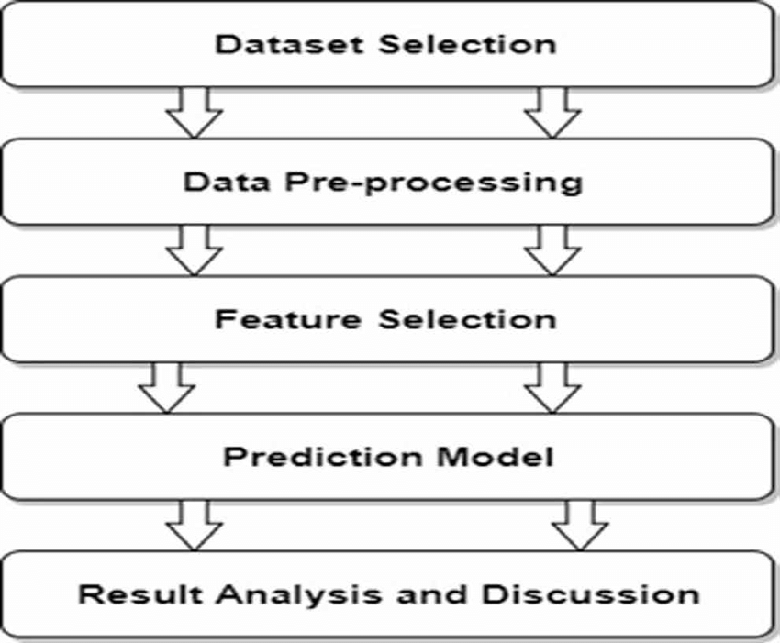
Project Flow

Slide 13
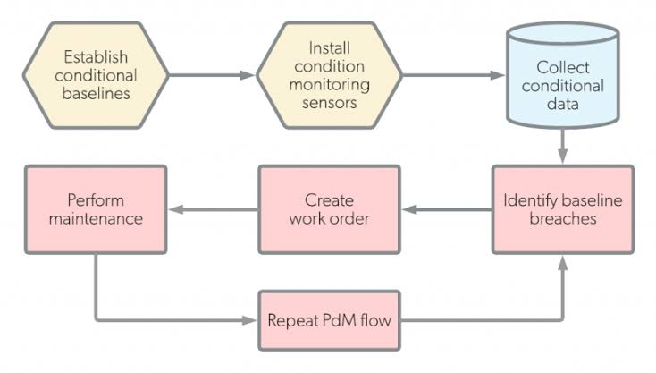
Block Diagram

Slide 14
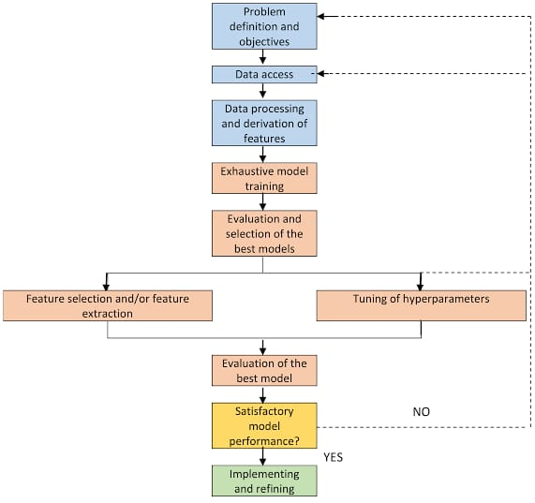
Block Diagram

Slide 15
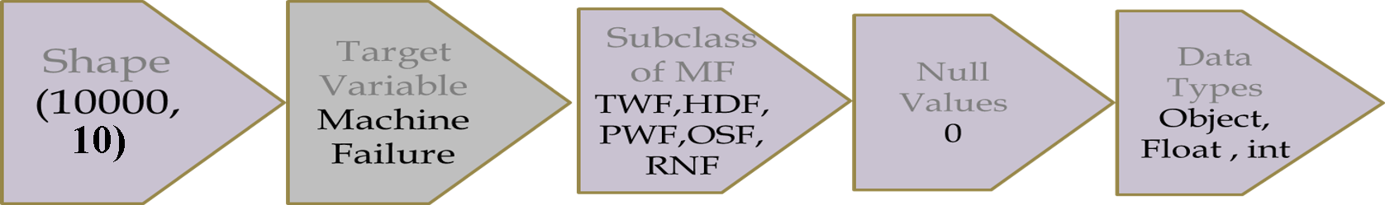
EDA
Exploratory Data Analysis (EDA) is an approach to analyze the data using visual techniques. It is used to discover trends, patterns, or to check assumptions with the help of statistical summary and graphical representations.
The main purpose of EDA is to help look at data before making any assumptions. It can help identify obvious errors, as well as better understand patterns within the data, detect outliers or anomalous events, find interesting relations among the variables.

Slide 16
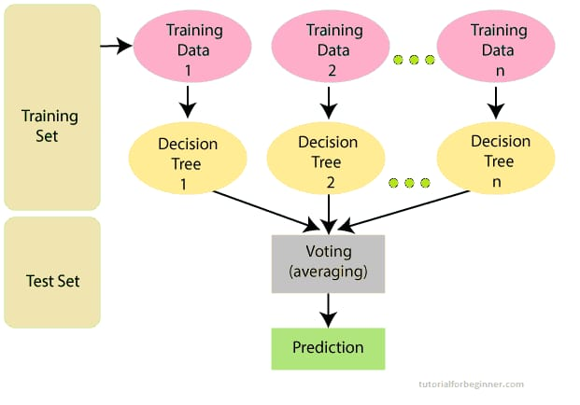
Model Building
The model building process involves setting up ways of collecting data, understanding and paying attention to what is important in the data to answer the questions you are asking, finding a statistical , mathematical or a simulation model to gain understanding and make predictions.
Random Forest Algorithm
Multi-Class Classification
Confusion Matrix
SMOTE Technique

Slide 17
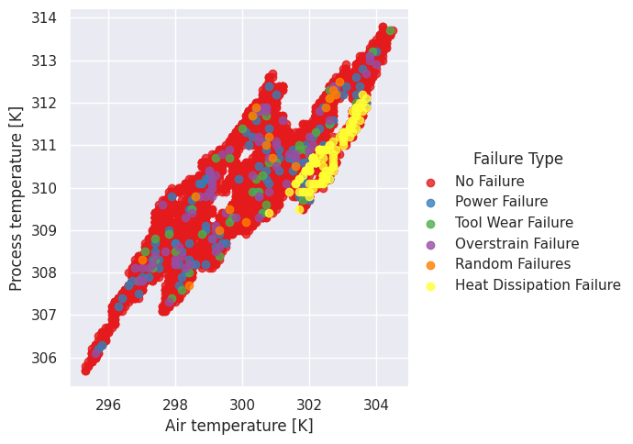
Result

Slide 18
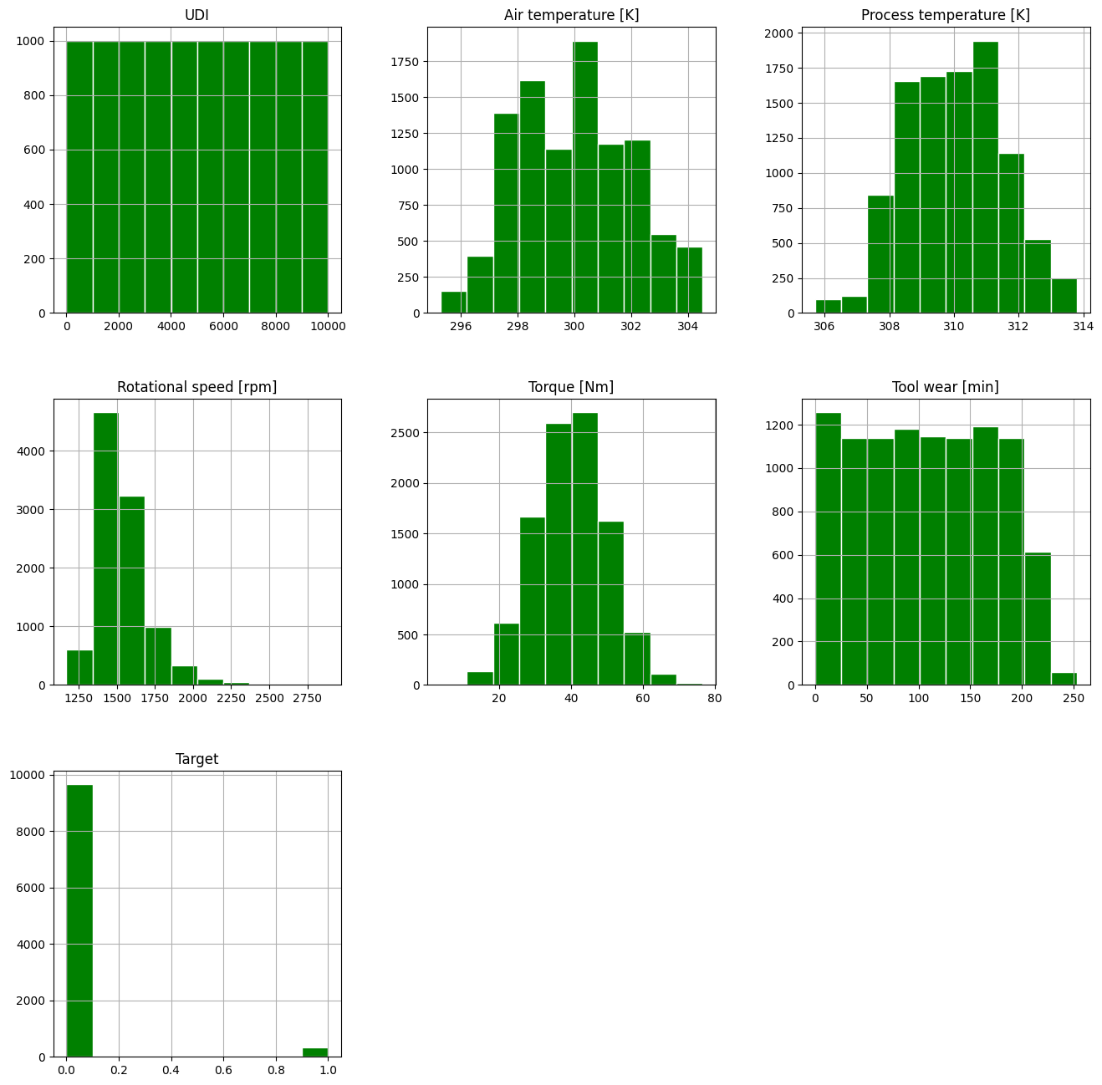
Result

Slide 19
Conclusion
This model proposes a system that will predict the failure of the manufacturing unit based on parameters like temperature and pressure, as well as machine parameters like speed, revolutions per minute, ams/ccm input, etc. These parameters are recorded by the sensors of the tubing machine over a period of time, and hence maintenance can be scheduled as per the requirements. This model will prove to be extremely useful in maintaining productivity and minimizing the cost of maintenance. This will reduce the time for which the unit remains idle and requires maintenance. The model was very effective in predicting the time when the machine would be down based on the previous historical sensor data that it received.

Slide 20
References
https://ieeexplore.ieee.org/document/8449150/references#references
https://ieeexplore.ieee.org/document/8732146
https://www.researchgate.net/publication/360724726_Predictive_Maintenance_using_Machine_Learning

Slide 21
Thank you

